Slide 1


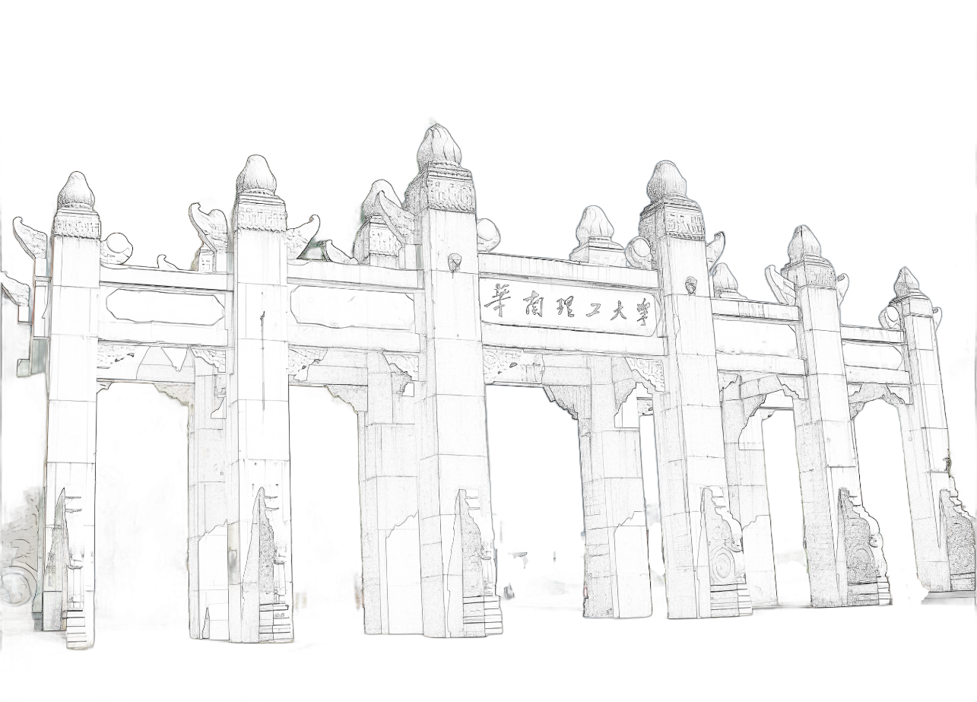

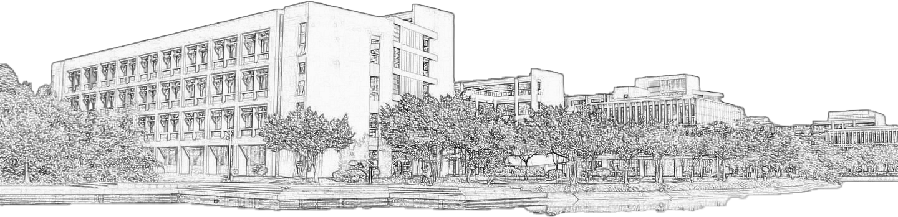
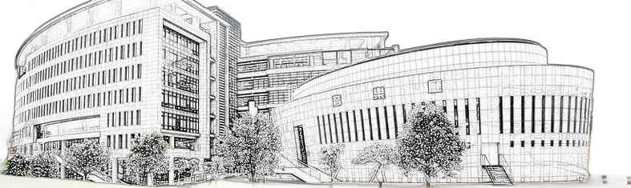
Green Computing Across Intelligent Systems From Nano-Devices to Networked AI
Reporters：
Sunny
Freya
Francis
Aidenberk
Sidra Khan
Charles
Date：2025.11.17

Slide 2



Green Materials & Transistors for Low-Power Electronics
01
CONTENTS
Reporters: Sunny, Freya
Photonics Computing for High-Efficiency Processing
02
Reporters: Francis, Aidenberk
Sustainable Machine Learning & Probabilistic Learning (ML/PL)
03
Reporters: Sidra Khan, Charles

Slide 3

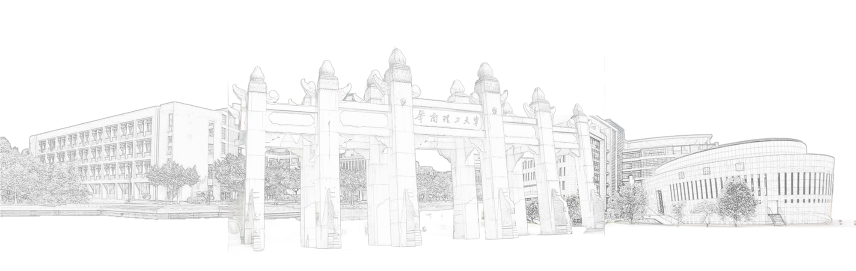
P
A
1
Topic
R
T
Green Materials & Transistors for Low-Power Electronics

Slide 4


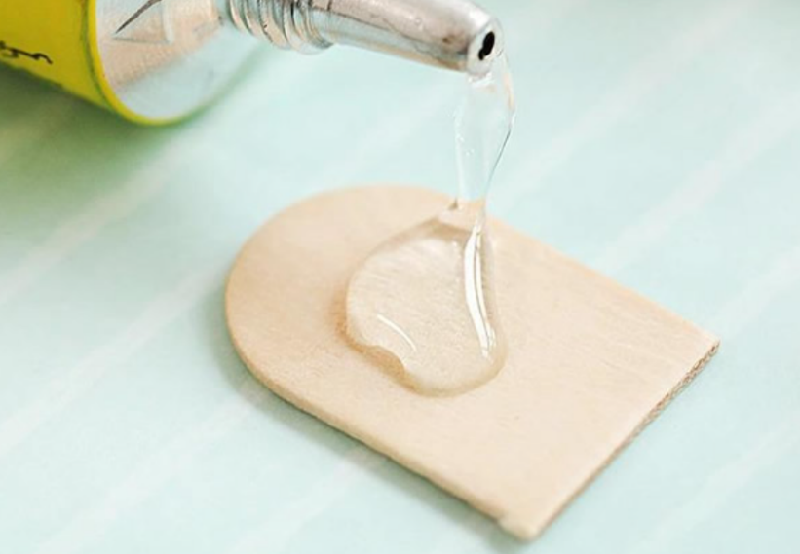
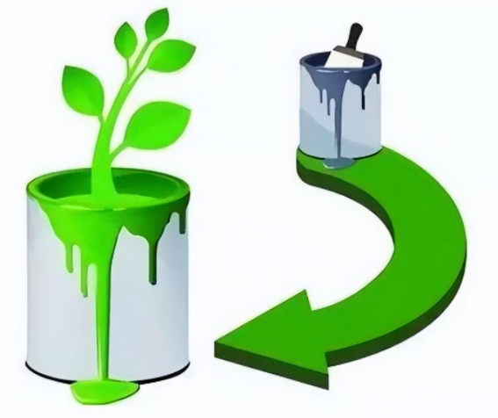
前沿软物质学院
SCHOOL OF EMERGENT SOFT MATTER
Green, environmentally friendly, and biodegradable polyester-based adhesives
Group 2 — Sunny
November 17, 2025

Slide 5
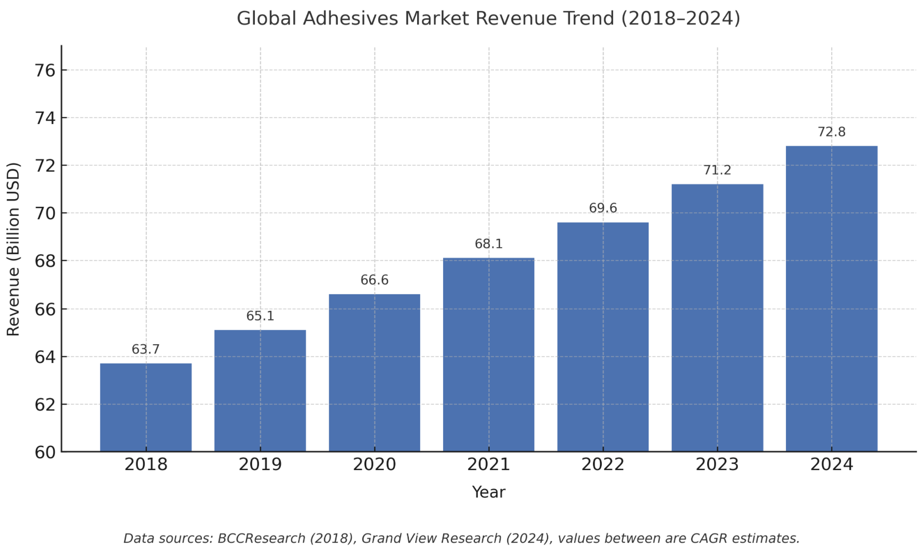
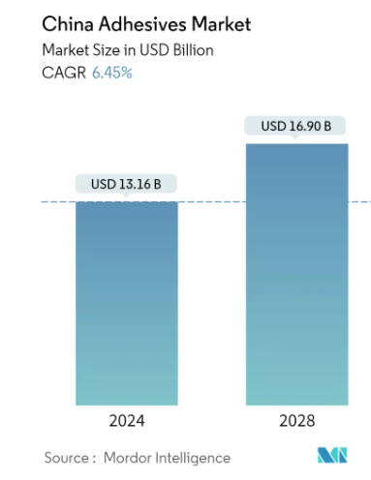
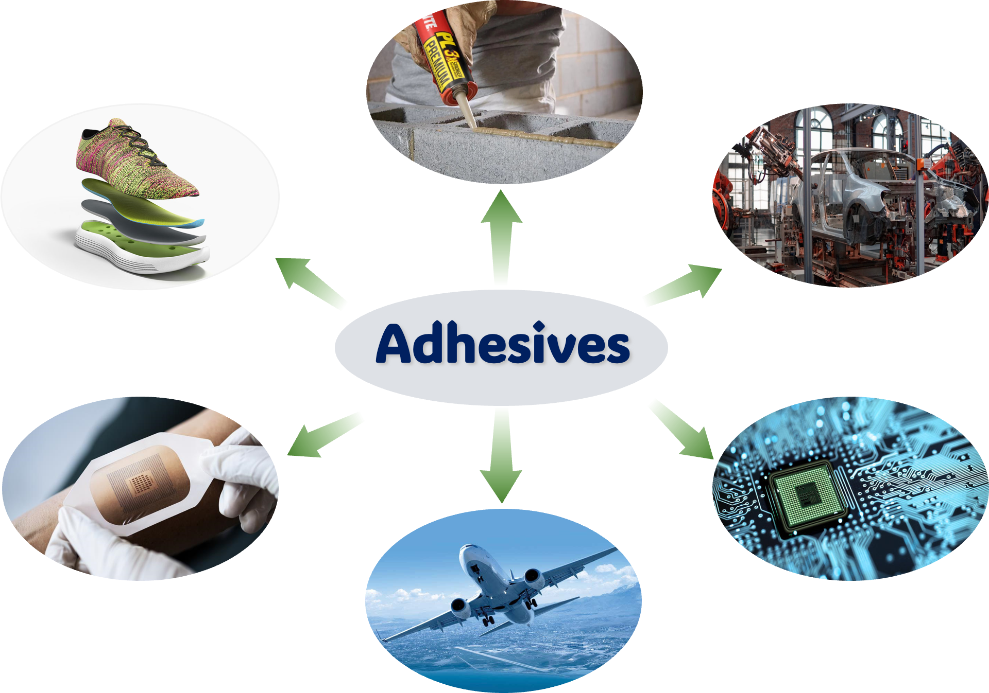
The application of adhesives
前沿软物质学院
SCHOOL OF EMERGENT SOFT MATTER
architecture
clothing
auto industry
The global demand for adhesives is rising year by year
The consumption in the Chinese market is expected to reach USD 16.90 billion by 2028.
medical treatment
electronic engineering
aerospace
The recycling and sustainable use of waste adhesives has become a hot research topic

Slide 6
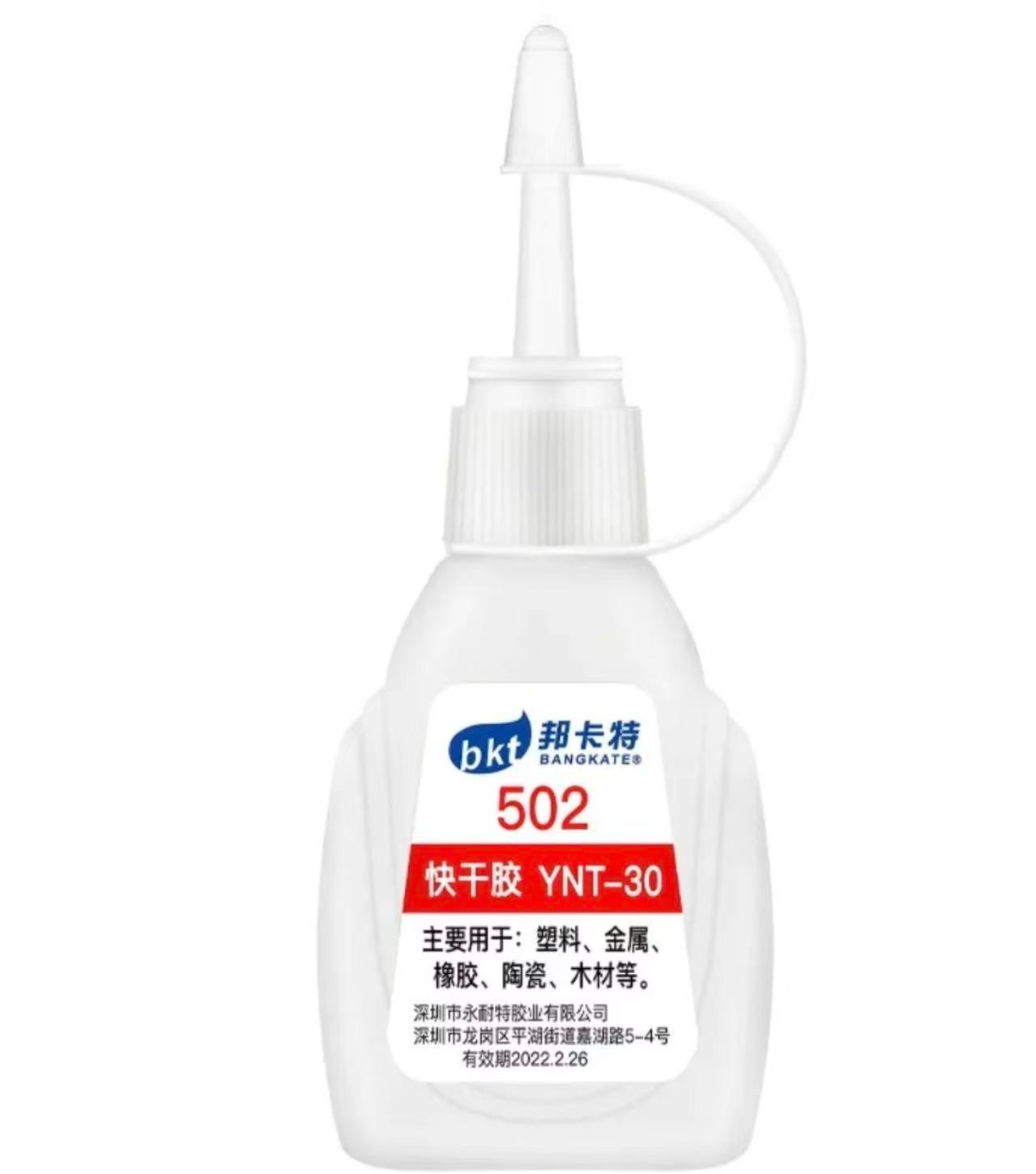


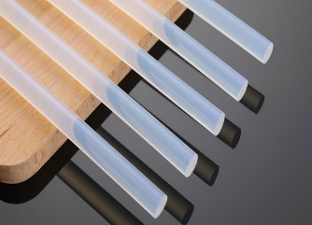
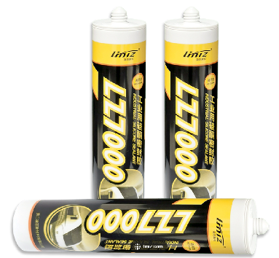
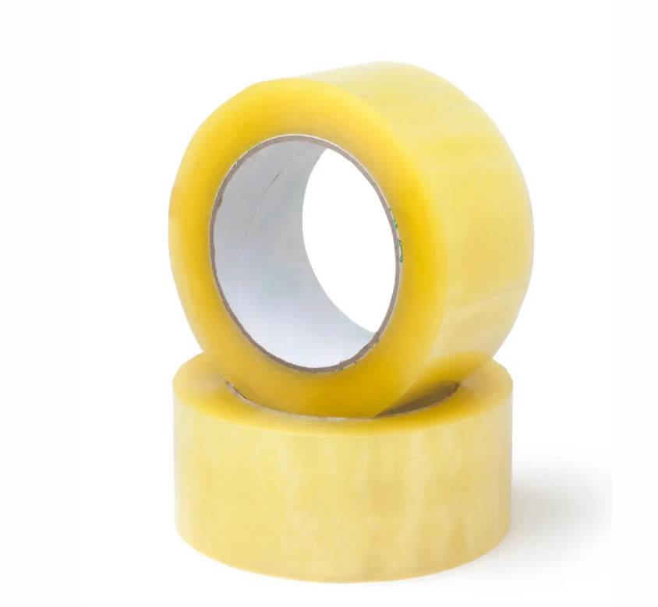
Sustainable adhesives
前沿软物质学院
SCHOOL OF EMERGENT SOFT MATTER
Cyanoacrylate
EVA - based
Silicone - based
Sustainable adhesives
Tape Type
VS
biocompatibility
biodegradability
environmental friendliness
Traditional adhesives

Slide 7
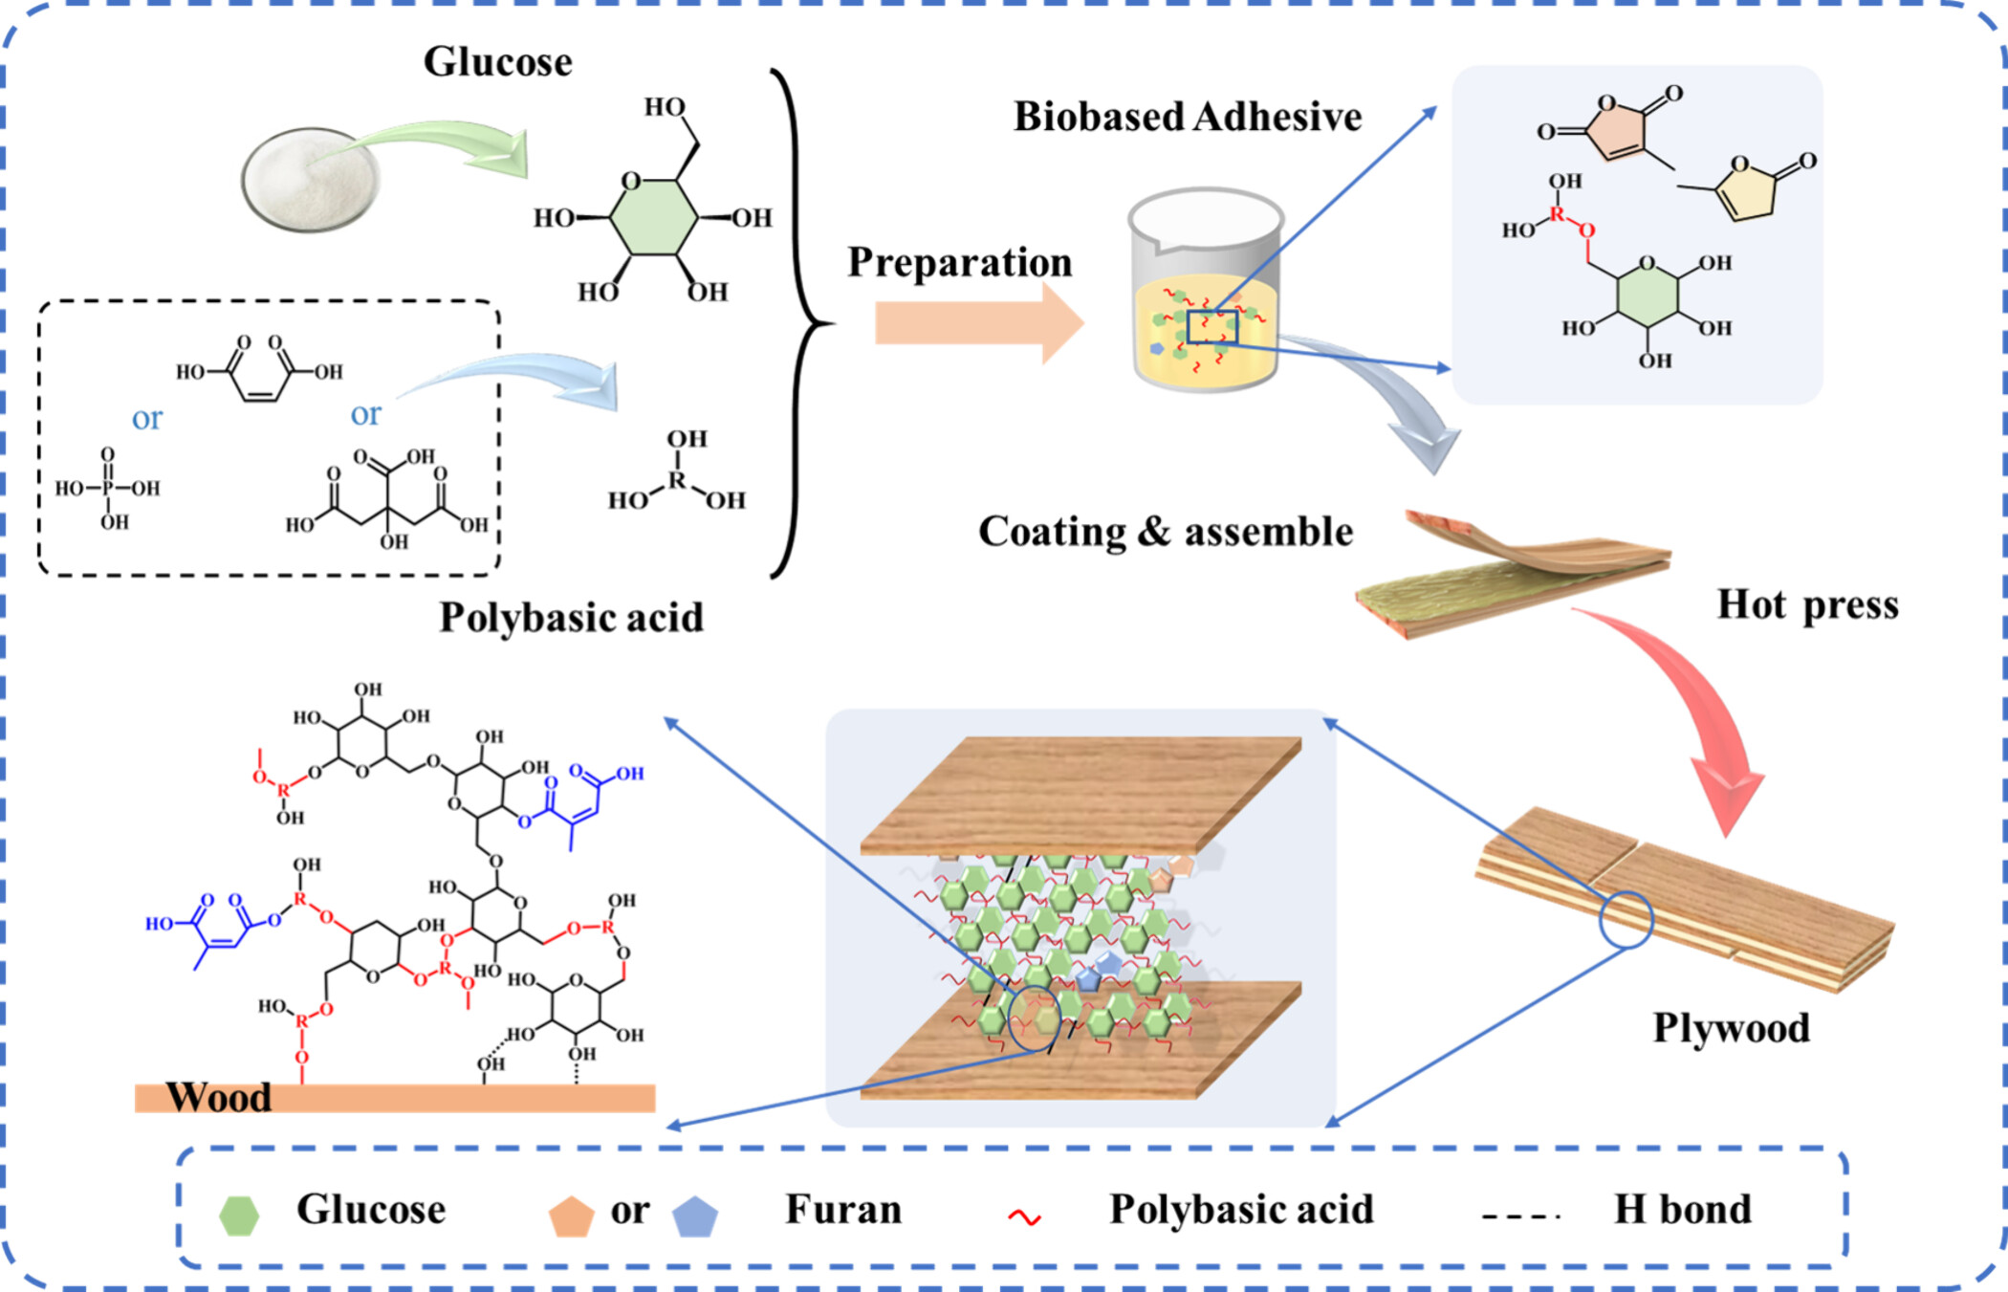
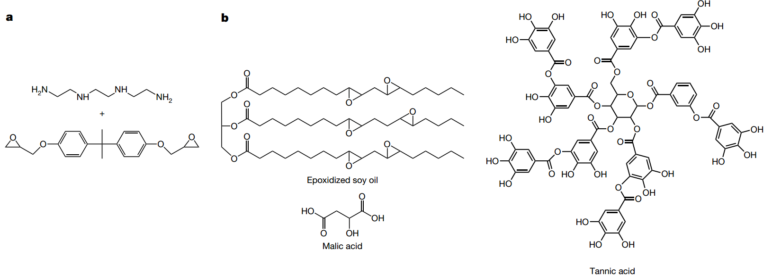
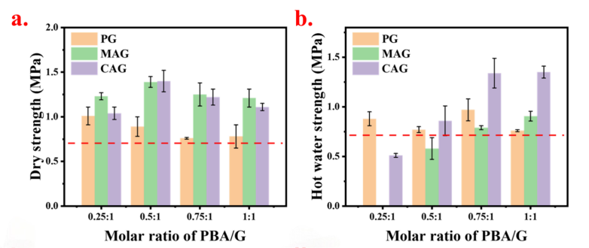
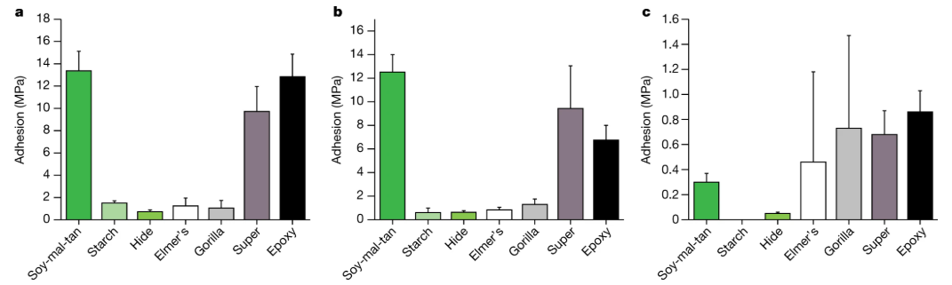
Research progress
前沿软物质学院
SCHOOL OF EMERGENT SOFT MATTER
Polysaccharide-based adhesives
Plant-oil-based adhesives
ACS Sustainable Chem. Eng. 2024, 12, 7831−7843
Nature 621. 2023, 306–311

Slide 8
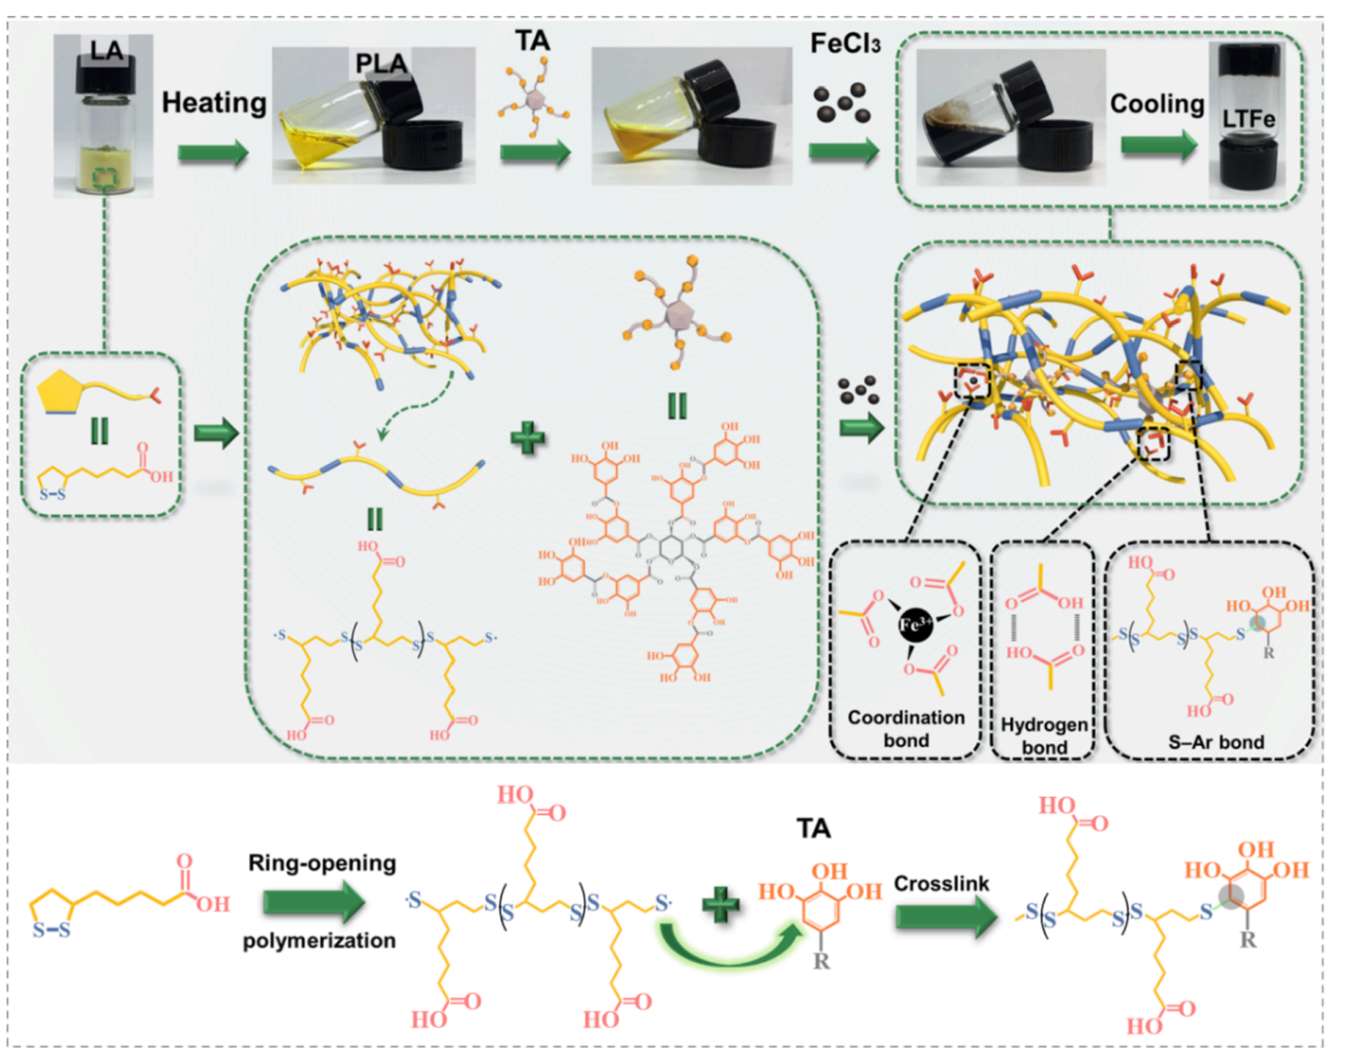
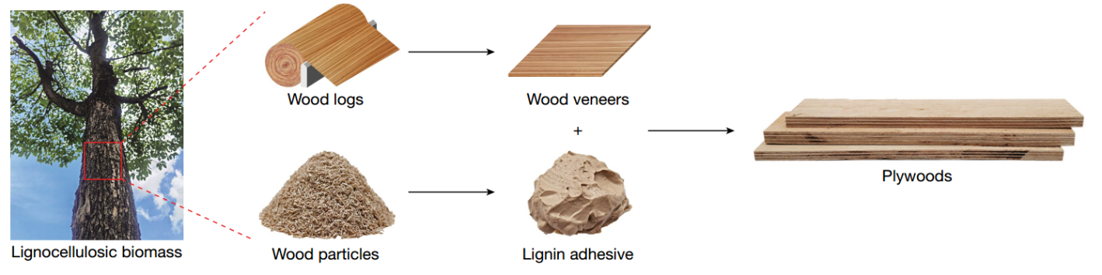
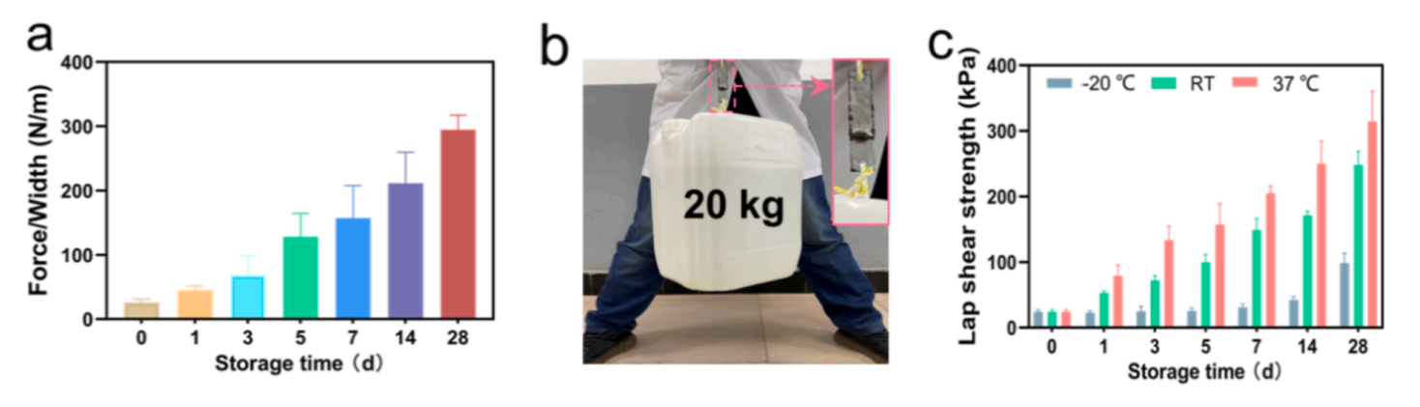
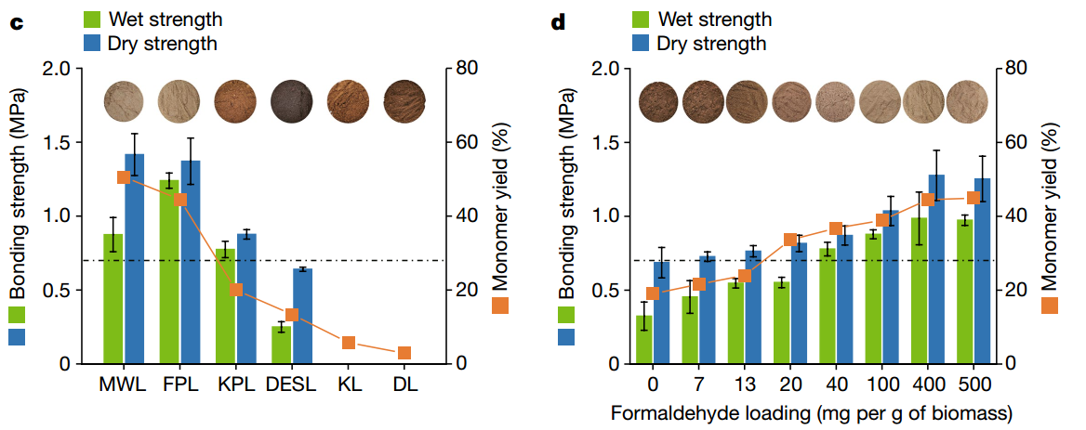
Research progress
前沿软物质学院
SCHOOL OF EMERGENT SOFT MATTER
Tannic acid-based adhesives
Lignin-based adhesives
Chem. Eng. J. 442 (2022) 136206
low bonding strength, high viscosity, and poor water resistance
not fully biodegradable
Nature 621, pages511–515 (2023)

Slide 9
Research progress
前沿软物质学院
SCHOOL OF EMERGENT SOFT MATTER
Poly(3-hydroxybutyrate) (P3HB)
P3HB is a naturally produced biodegradable polyester which can be considered a strong candidate for the next generation of environmentally friendly adhesives.
Biologically produced P3HB is very brittle, it has almost no adhesion.
stereochemical structure is uniform, its adhesion cannot be adjusted.

Slide 10
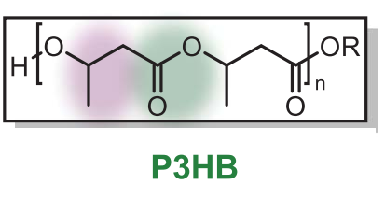
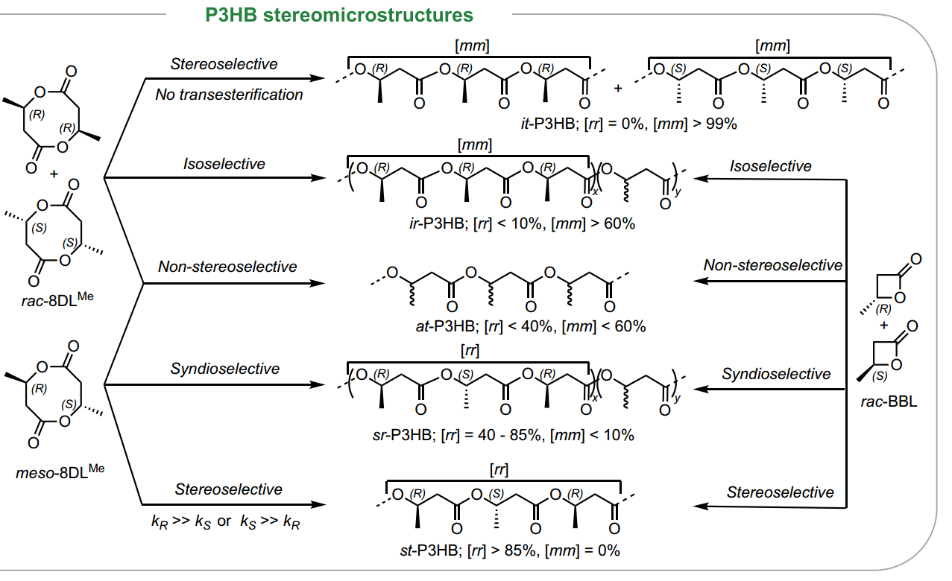
Research progress
前沿软物质学院
SCHOOL OF EMERGENT SOFT MATTER
Polyester-based adhensives
P3HB contains ester groups along the polymer chain and hydroxyl end groups, which can form strong physical interactions with different substrate surfaces.
the repeating unit of P3HB has a PP-like structural motif, and the stereochemistry of the chiral carbon in the backbone affects the thermal and viscoelastic properties of the polymer.
Science 387. 2025, 297–303

Slide 11
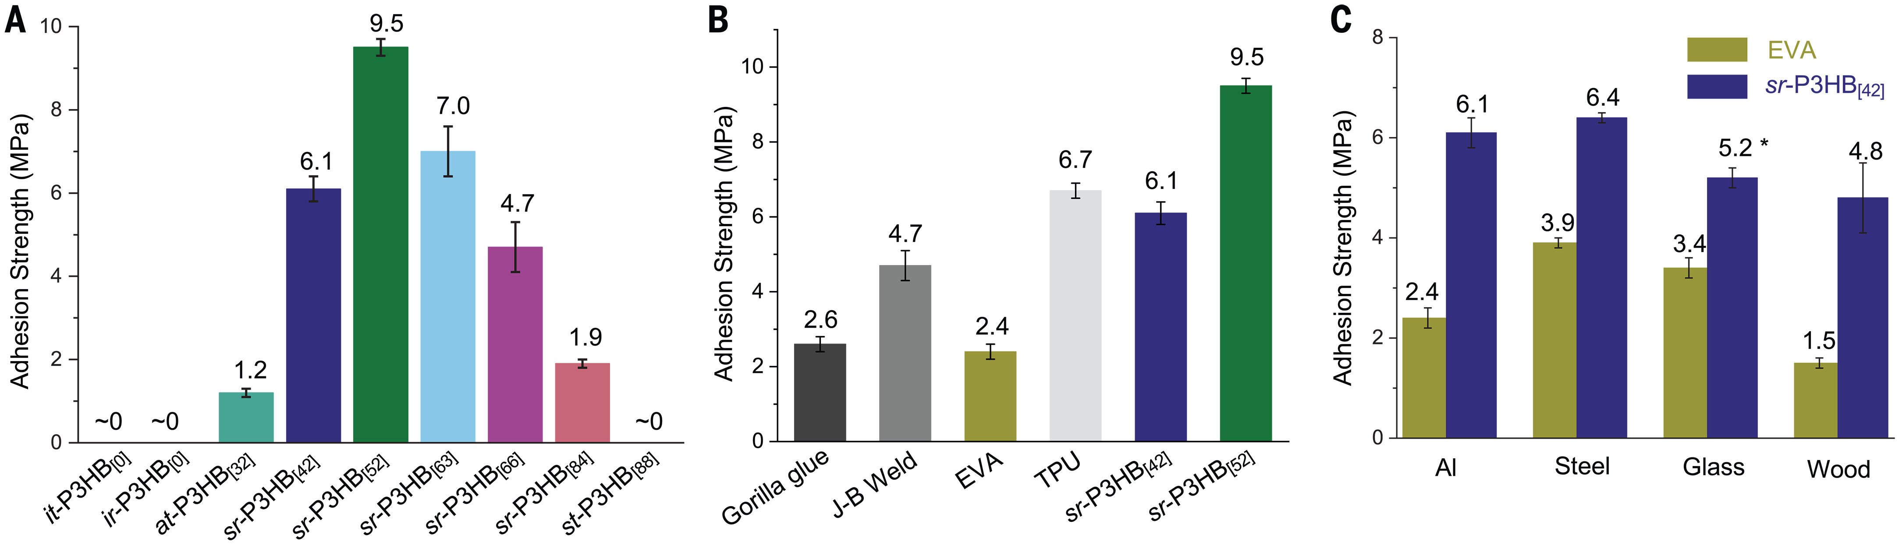
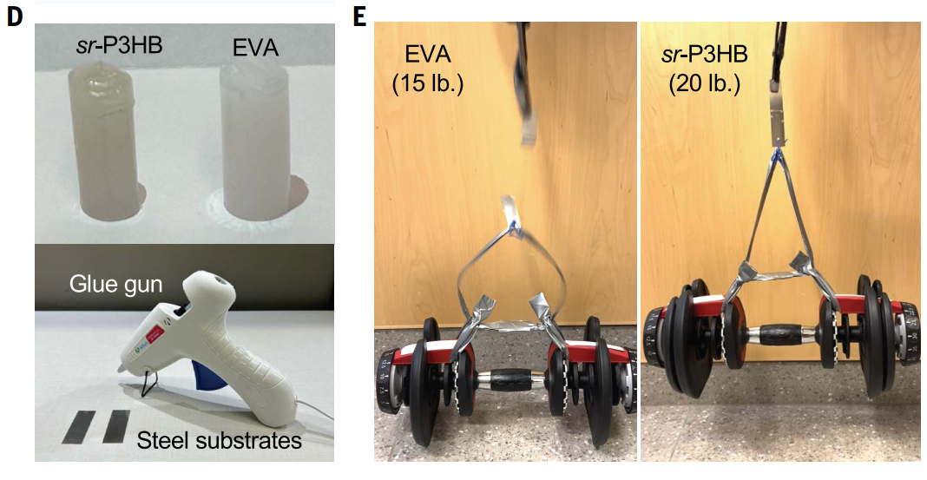
Research progress
前沿软物质学院
SCHOOL OF EMERGENT SOFT MATTER
P3HB exhibited great adhesion strength on various substrates, with a maximum value of 9.5 MPa.
P3HB adhesives can be cost-competitive with the petroleum-based nonrecyclable or nonbiodegradable incumbent adhesives.

Slide 12
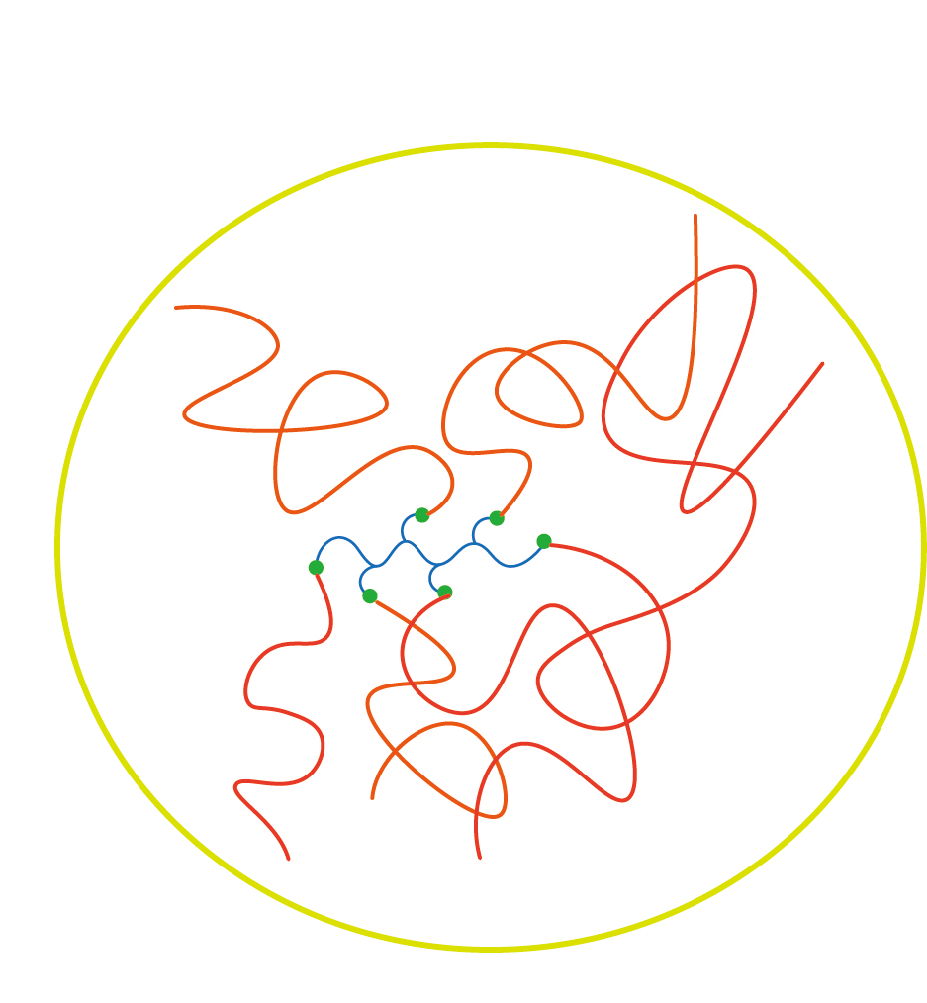

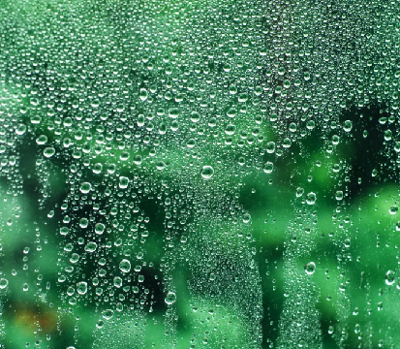
Prospectives
前沿软物质学院
SCHOOL OF EMERGENT SOFT MATTER
Future studies will focus on tune the microstructure or topology of polyesters to adjust their adhesion properties
Explore the applications of biodegradable adhesives in different scenarios
Explore melt-blending extrusion technology to achieve efficient and stable industrial-scale production

Slide 13
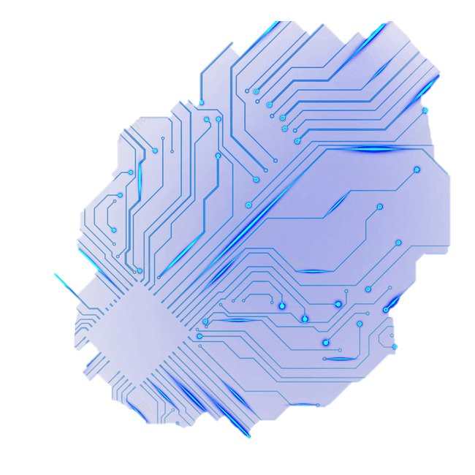

Organic Electrochemical Transistors (OECTs) and Applications
21 Freya
2025.11.17

Slide 14

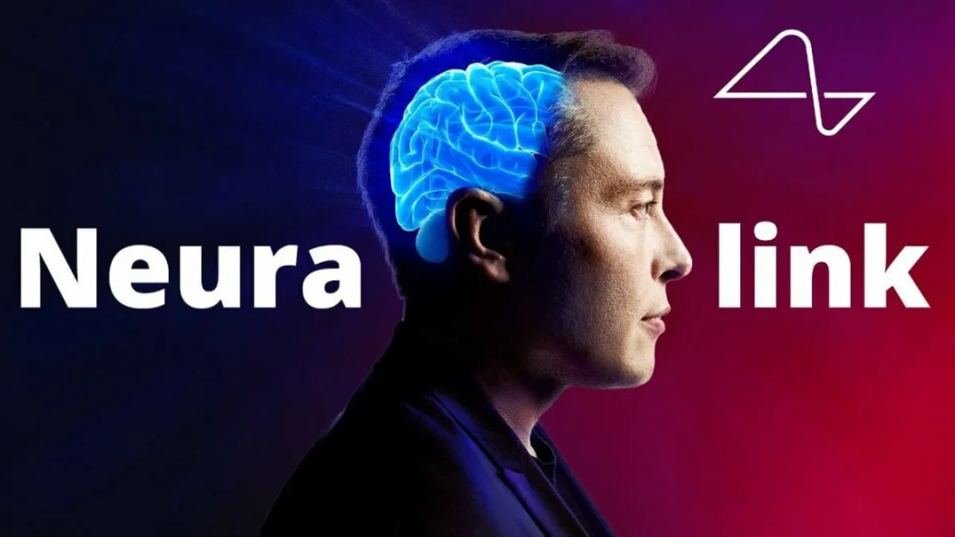
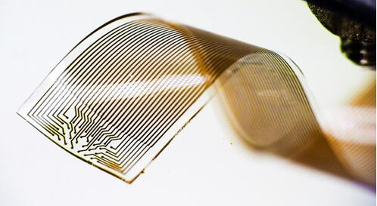
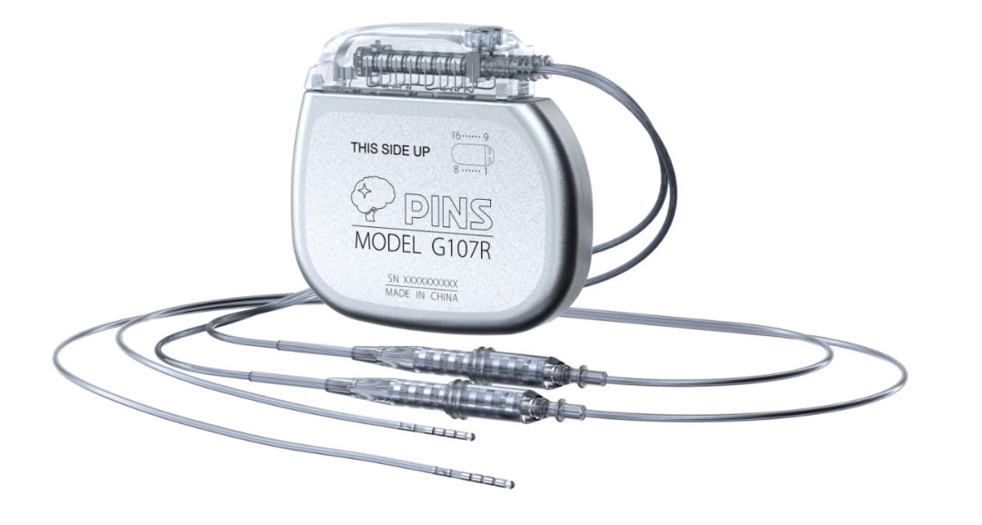
Flexible Brain-Computer Interface Technology
Neuralink
Flexible Electrode Array
Implantable devices
In November 2023, the FDA approved the initiation of human clinical trials.
In March 2024, the first human implantation was successfully completed.
Challenges：Electrode migration, detachment, and reduced signal-to-noise ratio (SNR)

Slide 15
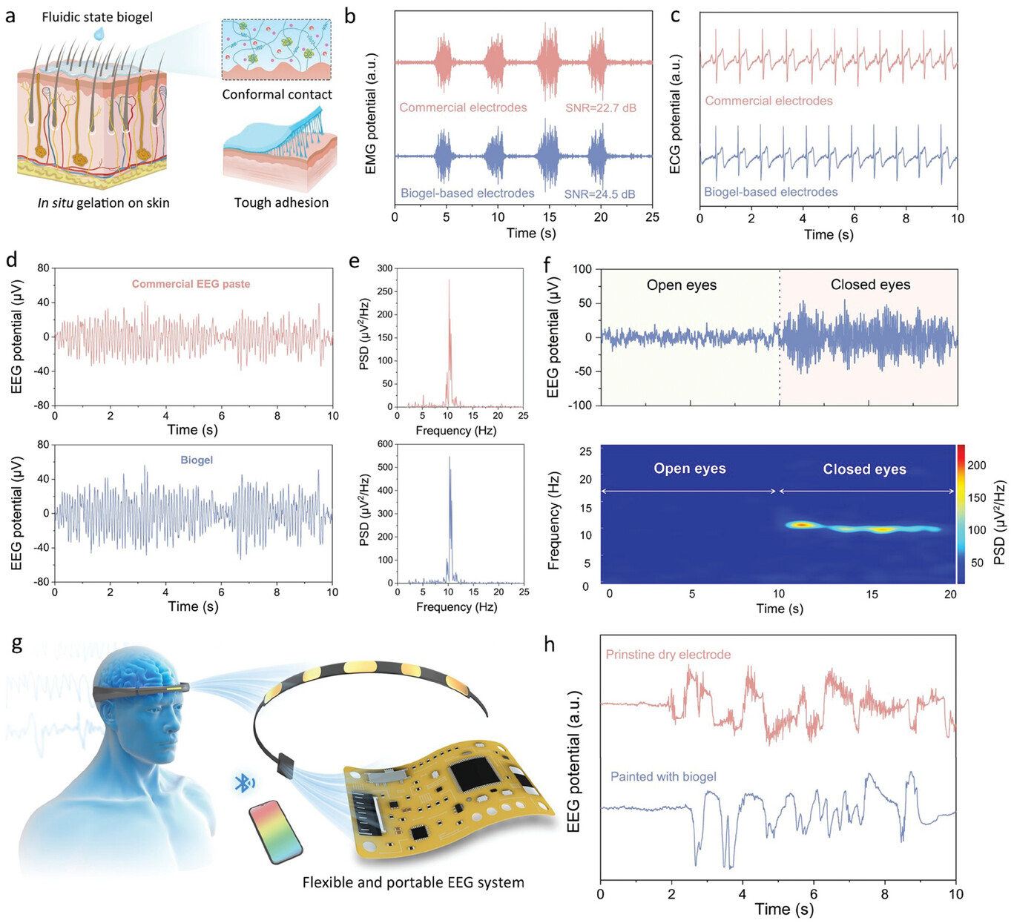
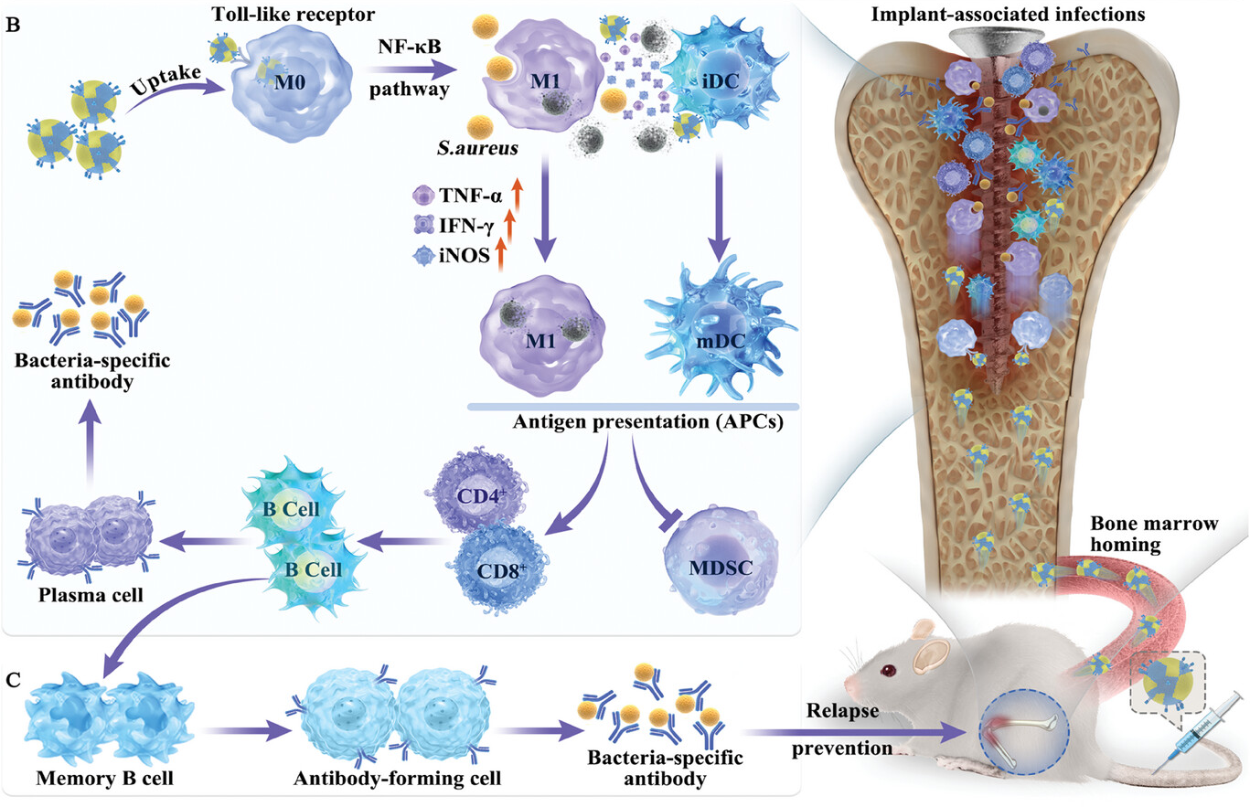
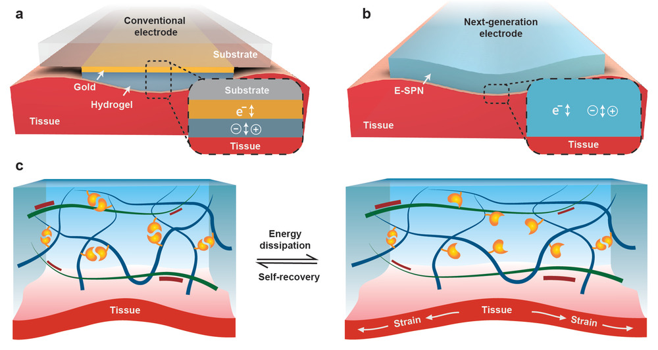
Challenges
前沿软物质学院
SCHOOL OF EMERGENT SOFT MATTER
Mismatch in interfacial properties
Low signal amplitude & high noise levels
Poor tissue-device interface
Biocompatibility & Adhesion
Adv. Sci. 2025, 12, 2415379
Adv. Mater. 2024, 36, 2401151
Adv. Mater. 2023, 35, 2207634
Flexible interface technology is still in its early stages, and a wide range of device types remains to be explored.

Slide 16
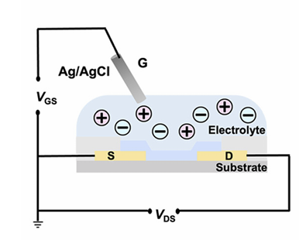
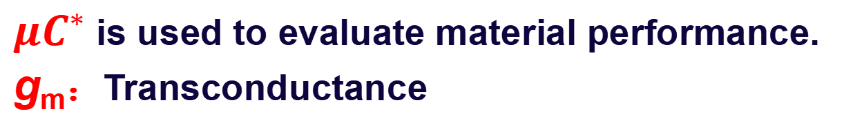
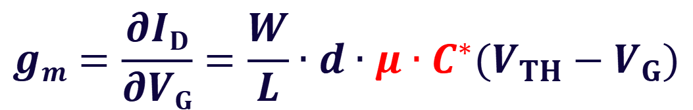
Organic Electrochemical Transistors
前沿软物质学院
SCHOOL OF EMERGENT SOFT MATTER
Organic electrochemical transistors (OECTs) exhibit high sensitivity and offer distinct advantages in biological sensing applications.
OECT properties：
Soft bio-interface compatibility
Operate in aqueous environments
Low-voltage operation (<0.8 V)
Excellent biocompatibility
$$gm=\frac{∂ID}{∂VG}=\frac{W}{L}∙d∙μ∙C^{∗}(V_{TH}−V_{G})$$
$μC^{∗}$is used to evaluate material performance.
g_{m}：Transconductance
npj Flexible Electron. 2025, 9, 1-19.

Slide 17
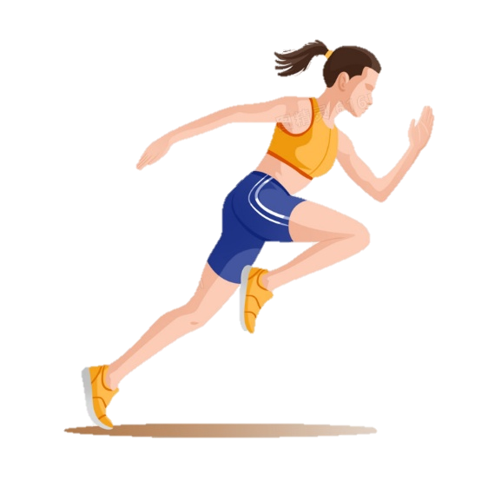
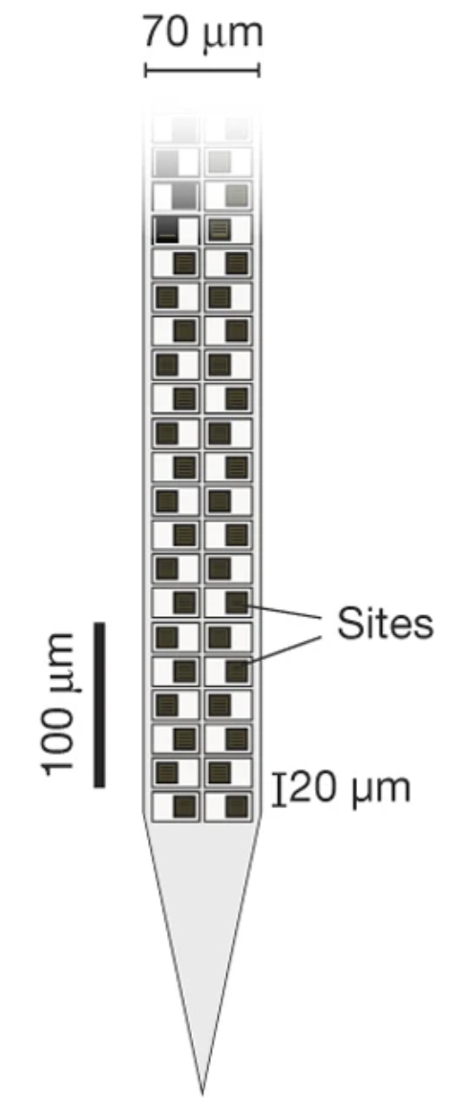
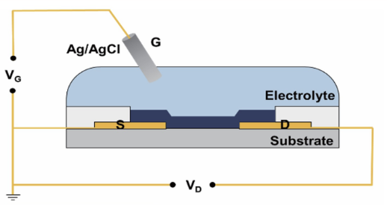
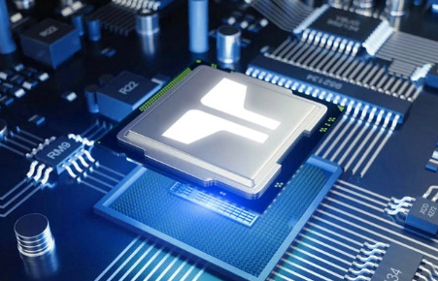


Advantages over traditional components
前沿软物质学院
SCHOOL OF EMERGENT SOFT MATTER
Traditional electrode devices
Traditional OECT devices
Signal Acquisition
Signal Processing
Signal Acquisition
Amplification
Filtering
OECT
Amplification
Filtering
Signal Processing
Amplification
Multiplexing
High SNR
Filtering
Digital-to-Analog Conversion (DAC)
Multiplexing
Highly Integrated
Neural Electrode
Low-Power
Signal Transmission
Digital-to-Analog Conversion (DAC)
Nature 2017, 551, 232-236

Slide 18
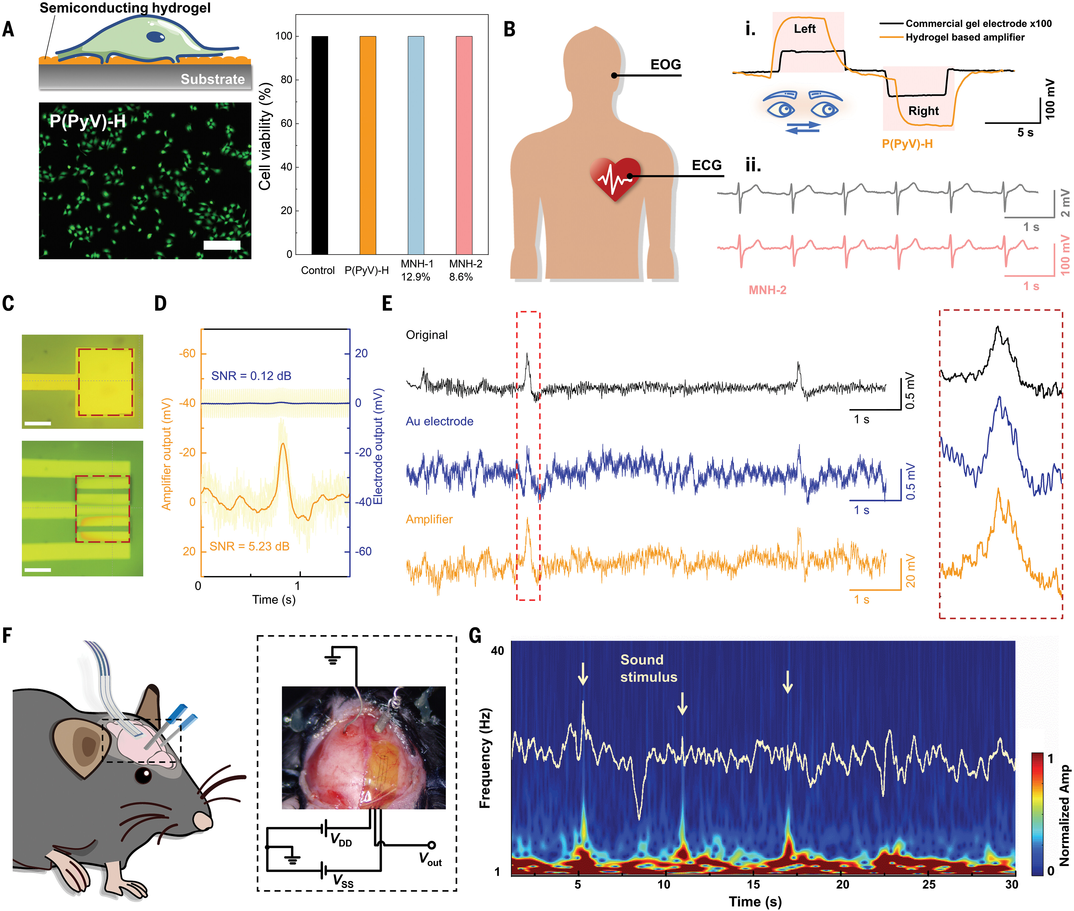
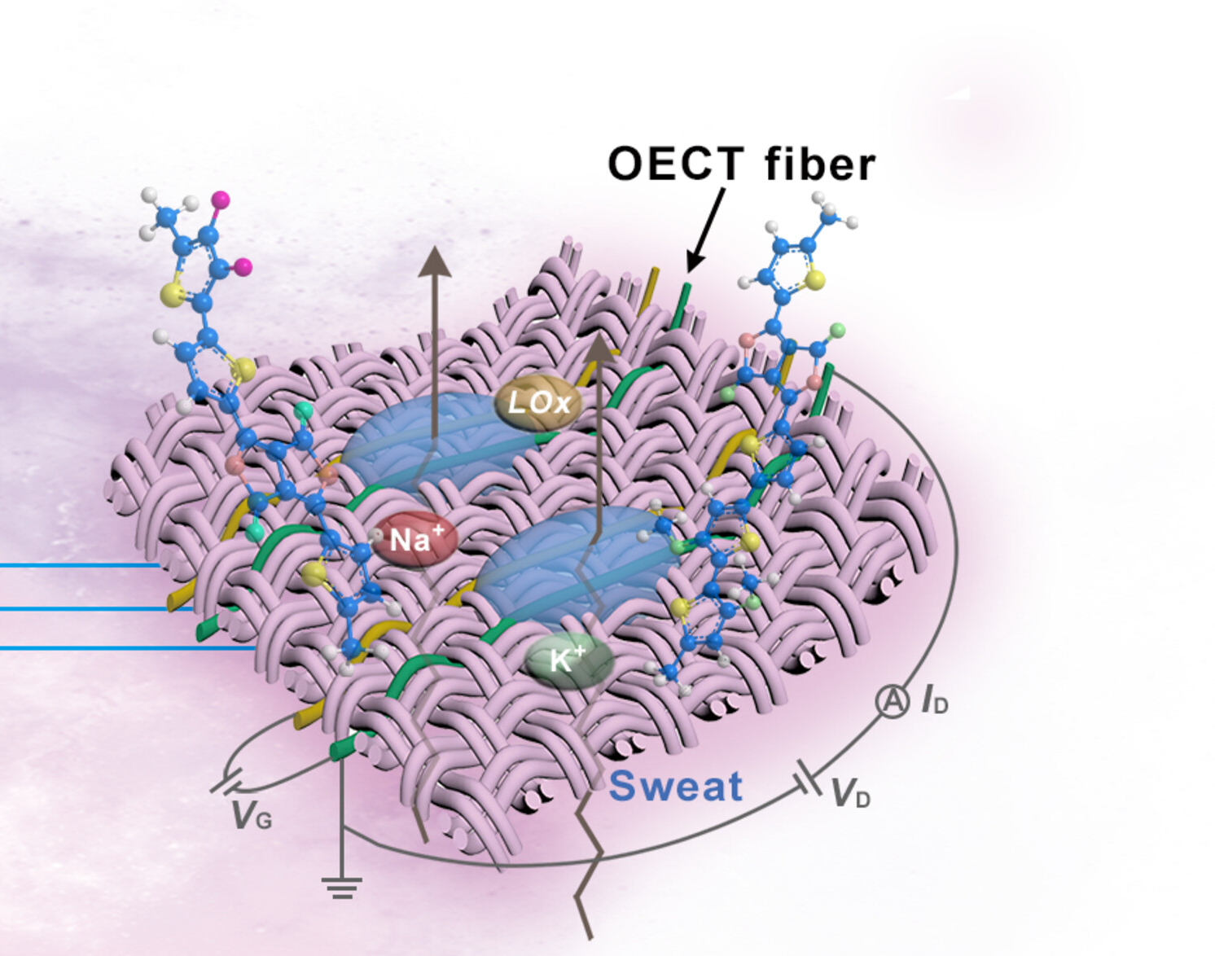
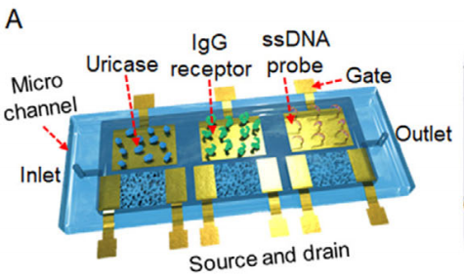
Application
前沿软物质学院
SCHOOL OF EMERGENT SOFT MATTER
Electrophysiological Signals
Chemical Signals
Lei Groups developed the semi-conducting hydrogel. They used OECT technology with this material to amplify brain signals.
And they designed OECT fiber devices to detect glucose and lactate. Beyond that, OECTs can also detect various biomolecules.
Science 2024, 384, 557-563 Sci. Adv. 2024, 10, eadk0647 Adv. Mater. 2025, e09290 Anal. Chem. 2022, 94, 7584-7593

Slide 19

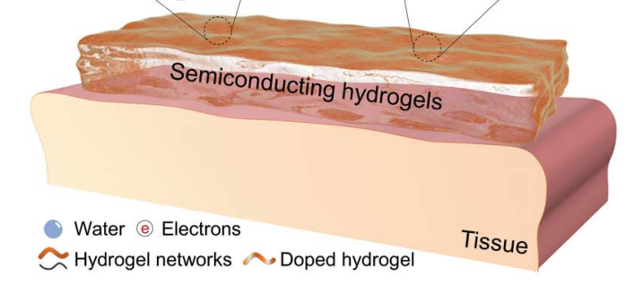
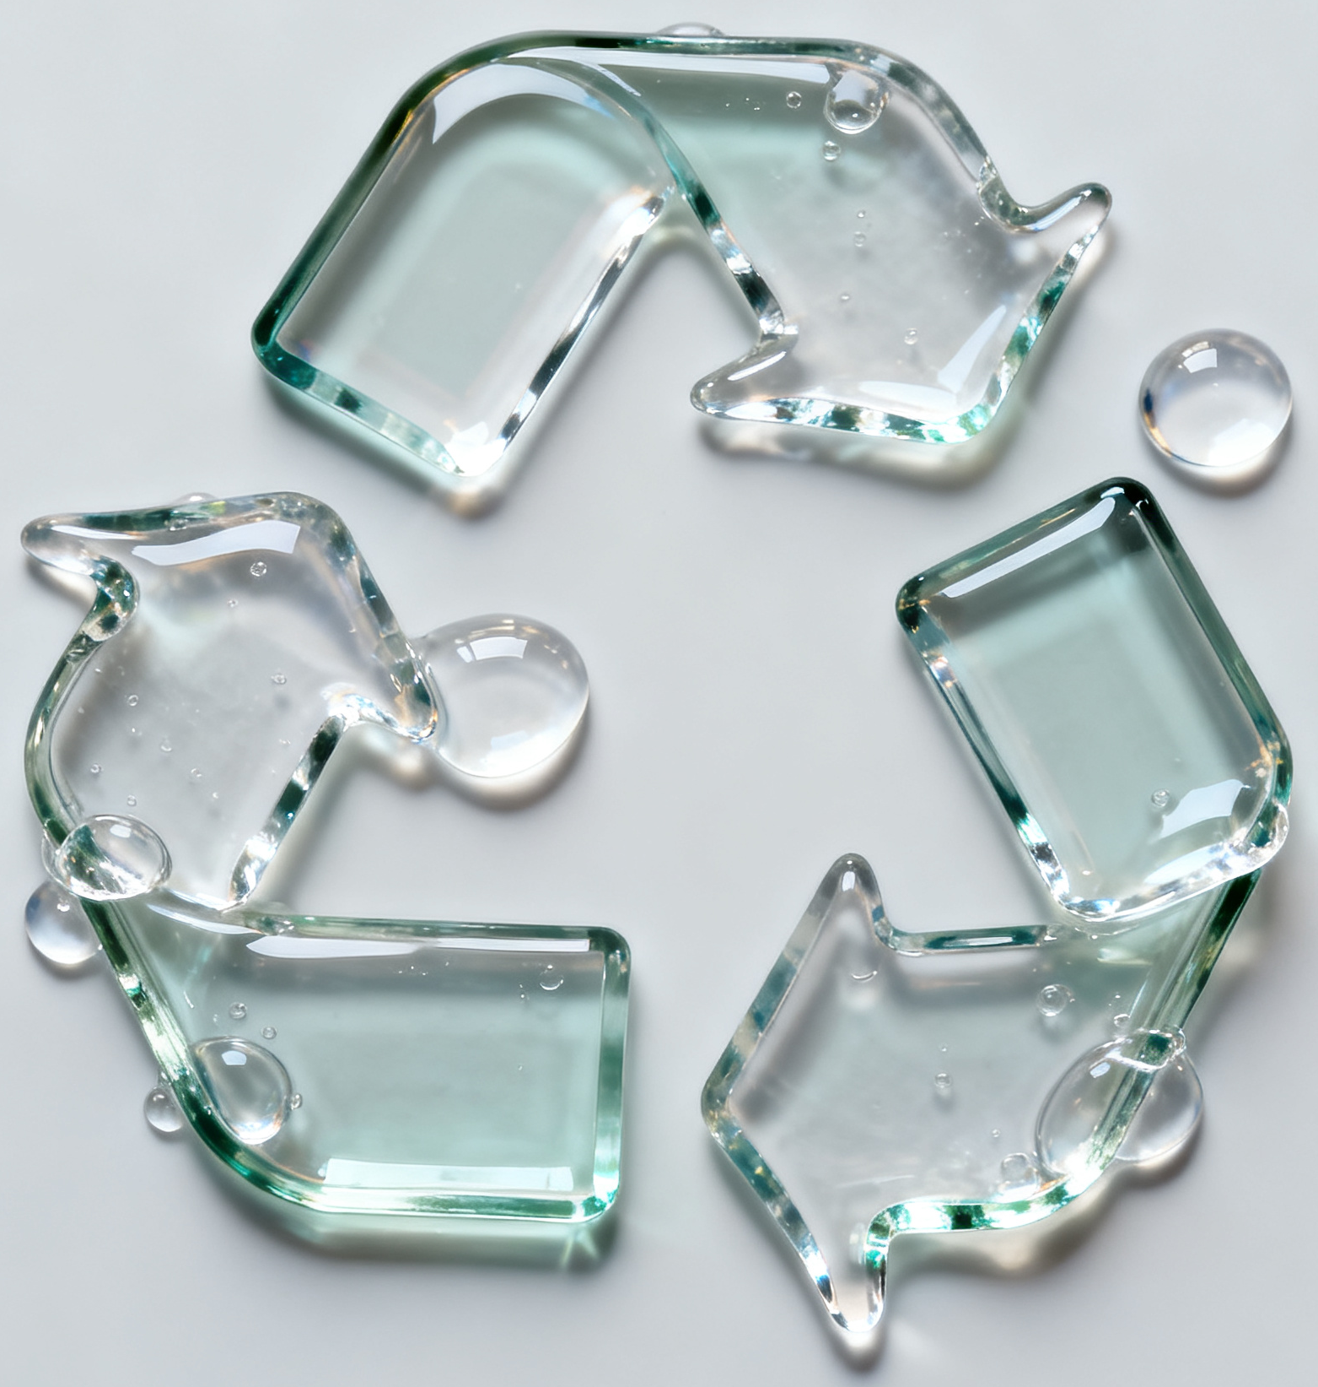
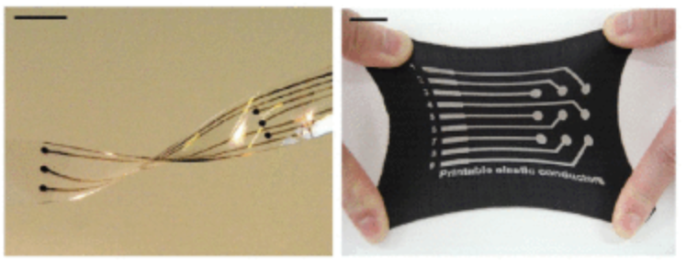
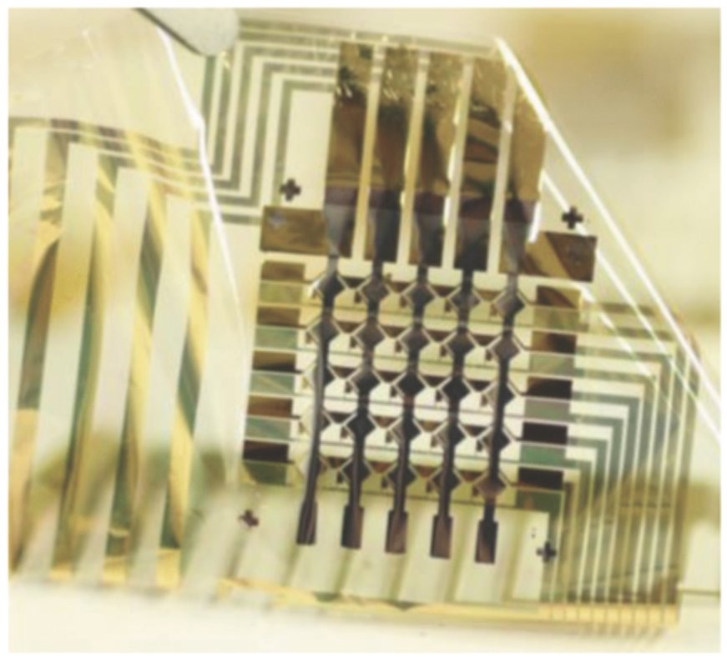
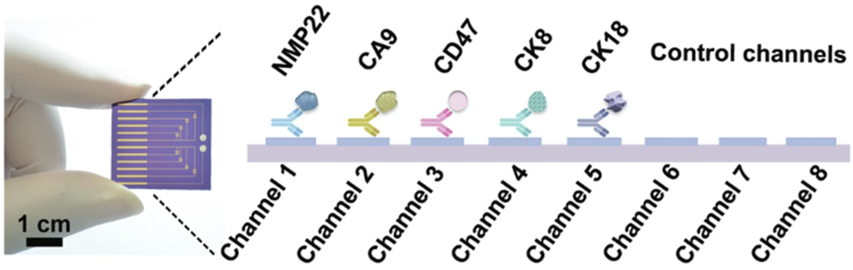
Conclusion and Prospectives
前沿软物质学院
SCHOOL OF EMERGENT SOFT MATTER
Materials
Reduce costs and use biodegradable or recyclable materials.
Science 2024, 384, 557-563
Device Architecture
Construct softer, more flexible, and highly integrated devices.
OJ-NANO 2022, 3, 101-115
Applications
Develop high-sensitivity devices for the concurrent detection of multiple substances.
Adv. Mater. 2022, 34, 2203224

Slide 20

P
A
2
Topic
R
T
Photonics Computing for High-Efficiency Processing
1

Slide 21

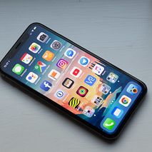


Electronic Computing
未来技术学院
SCHOOL OF FUTURE TECHNOLOGY
Smartphones
Internet searches
Online gaming
All these technologies are powered by traditional "electronic computers."
Notes:
The Foundation of Our Digital World

Slide 22

Inside the Electronic : How a CPU works
未来技术学院
SCHOOL OF FUTURE TECHNOLOGY
Imagine an incredibly fast mail carrier (an electron) running through a complex city grid (a circuit) to deliver messages (data)
The CPU can process data much faster than it can be retrieved from memory
Electrons moving through wires generate heat
Transistors on a chip are becoming so small that we are approaching the physical limits of silicon, with current state-of-the-art chips already being manufactured using a 3-nanometer process.

Slide 23
Electronic
Computing

Slide 24
Photonics
Computing

Slide 25
Why Photonic?
未来技术学院
SCHOOL OF FUTURE TECHNOLOGY
Incredible Speed
Parallelism
Low Energy
Photons travel at the speed of light, the fastest possible speed in the universe, far exceeding the speed of electrons in a wire.
A single beam of light can contain many different colors (wavelengths). Each color can carry a separate stream of data without interfering with the others (Wavelength Division Multiplexing). This allows for massive parallel processing naturally.
Light traveling through optical materials generates virtually no heat, meaning energy loss is minimal. This leads to significantly lower power consumption and no need for bulky cooling systems.
Notes:
The Foundation of Our Digital World

Slide 26

Optical 4f System
未来技术学院
SCHOOL OF FUTURE TECHNOLOGY
The optical 4f system is a typical optical transfer system consisting of two lenses with a focal length of f, which can achieve a Fourier transform of the input optical ﬁeld. After the input signal is transformed from the time domain to the frequency domain, the frequency spectrum of the input signal can be modiﬁed or modulated conveniently in the Fourier plane to obtain the corresponding output response.
The work of using a 4f system to perform matrix multiplication has been validated. The frequency domain information at the Fourier plane can be designed and modulated to achieve the inference function of ONNs
Notes:
The Foundation of Our Digital World

Slide 28

The Components of a Photonic Chip
未来技术学院
SCHOOL OF FUTURE TECHNOLOGY
1
Laser
The source that generates the light
Components
Laser
Chip
4
Interferometer
Interferometer
The core computing components that use the wave nature of light to perform mathematical operations like multiplication and addition.
2
Modulator
Encodes data onto the light beam, much like putting a letter in an envelope for the messenger
Modulator
5
Detector
Detector
Read the result by converting the light signal back into an electrical signal that a traditional computer can understand.
Waveguide
3
Waveguide
The channel that guides the light. Think of it as a fiber optic cable on a chip

Slide 29


Challenges
未来技术学院
SCHOOL OF FUTURE TECHNOLOGY
New Materials and Structures
Miniaturization
Continuing to explore and develop novel optical materials
Photonic components are currently larger than electronic transistors
Hybrid Electro-Optical Integration
Smarter Architectures
Optical Storage
Designing new chip layouts for tasks like AI.
Creating fast, on-chip optical memory to overcome data bottlenecks.
Combining the strengths of electronics and photonics to achieve high-speed, energy-efficient computation.

Slide 30
Implement of Electro-Optical
未来技术学院
SCHOOL OF FUTURE TECHNOLOGY
Electro-Optical
DNN
Hardware Abstraction Layer
The HAL presents both the electronic CPU and the photonic co-processor (PPU) as a single, abstract computing device. Programmers write code for this virtual device, not for the specific hardware.
Tasks
Electro-Optical
Task Scheduling (DAG)
To dynamically assign each computational task to the best processor (electronic or photonic) to maximize performance and efficiency.
Device

Slide 31

Directed Acyclic Graph (DAG)
未来技术学院
SCHOOL OF FUTURE TECHNOLOGY
Decide when to use light and when to use electronic

Slide 32
P
A
R
T
Optical Fault Tolerance for Stable and Energy-Efficient AI Computing
Presenter：Aidenberk
Notes:
Good afternoon everyone, I am the speaker Aidenberk, and the title of my speech is

Slide 33


Research Report
From Energy Crisis to Optical Opportunity
The Performance Gap: AI model complexity is growing hundreds of times faster than the hardware designed to support it.
The Energy Consequence: This creates an unsustainable energy crisis, with future AI models projected to consume more power than entire nations.
The Conclusion: The current path is unsustainable. We need a new computing paradigm.
Notes:
Firstly, our theme focuses on the current energy issues. From the left figure, it can be seen that AI is developing rapidly, but its hardware performance has encountered bottlenecks
Secondly, the figure on the right shows the energy usage plan of Open AI, especially in 2023 when the electricity consumption is almost equal to half of the electricity consumed in the United States

Slide 34

Research Report
Why Photonic computing？
Traditional CMOS-based computation faces a fundamental scaling limit in energy efficiency.
Emergeing as a green alternative — capable of massive parallelism, ultra-high bandwidth, and minimal resistive loss.
Feature / Metric | State-of-the-Art GPU (e.g., NVIDIA H100) | Optical Computing Chip (Current & Emerging) | Optical Computing (Theoretical Limit)
Core Technology | 4nm/5nm CMOS Transistors (Electronic) | Silicon Photonics, MZI¹ Arrays (Photonic) | All-Optical Logic, Lossless Media
Energy Efficiency (TOPS/W) | ~3 - 6 TOPS/W | ~20 - 100 TOPS/W | > 1,000 TOPS/W
Computational Latency | Microseconds (µs) to Milliseconds (ms) | Nanoseconds (ns) to Picoseconds (ps) | Picoseconds (ps) to Femtoseconds (fs)
Key Energy Bottlenecks | End of Moore's Law, data movement ("Memory Wall"), interconnect power | Inefficient O/E and E/O conversion, laser wall-plug efficiency | Laser efficiency, quantum noise limits
Representative Examples | NVIDIA (H100, A100), AMD (MI300) | Lightmatter, LightOn, Salience Labs, Optalysys | MIT, Caltech, Oxford University research
ENVISE
products of Lightmatter
Notes:
Why do we use optical computing? Firstly, traditional electronic chips have encountered performance bottlenecks, and from the table, it can be seen that their energy efficiency far exceeds that of electronic chips. Among them, TOP/W=1024 * 1024 million operations per second/watt.
The right picture of Lightmatter's product ENVISE shows the speed and performance of optical computing. The reason is that optical computing can perform multiple operations in a single area
我们为什么使用光计算，首先传统的电芯片已经遇到了性能瓶颈，而且从图片可以看出其能源效率远超电芯片，其中TOP/W=1024*1024 千百万次 operation per second/watt，右图Lightmatter 的产品ENVISE展示了光计算的速度以及性能，其原因是光计算能够在一片区域进行多次运算

Slide 35



Instability Issues in Optical Computing
However light can "drift" and make AI compute the wrong result.
Optical devices are sensitive to the environment.
Small variations in temperature, device aging, vibration, or signal loss may cause incorrect calculations.
Optical devices | Laser source | MZI | Waveguide
Problem | Power Fluctuation | Phase Drift | Crosstalk / Interference
Reason | Relative Intensity Noise | Thermo-Optic Effect Phase Drift | Evanescent Coupling
Notes:
However... The following are some core components of optical computing, and laser source is the energy source of optical computing. MZI is the computing core of optical computing, and Waveguide is equivalent to the transmission channel of light. They will all have different problems due to environmental issues, which will affect the calculation accuracy
然而。。。以下是光计算的一些核心器件，Laser source是光计算的能量来源。MZI是光计算的计算核心，Waveguide相当于光的传播通道，他们都会因为环境问题产生不同的问题从而影响计算精度

Slide 36


Our Solution
Optical Fault Tolerance
Mechanism makes optical computing accurate, stable, and trustworthy.
We train the AI to adapt to imperfect hardware, rather than trying to build perfect hardware.
1.Hardware Characterization and Noise Modeling:
We create a model to precisely predict the noise
and instability of optical chip in real-world.
2.Noise-Aware and neural network Training:
We inject this realistic hardware noise into the AI's training
process.
This forces the AI to learn to distinguish the signal from the noise,
making it inherently robust to hardware flaws.
Notes:
We introduce optical fault tolerance, which is a method that enables optical computation.. The mechanism. We will describe it from two aspects, the first being Hardware Characterization and Noise Modeling:The second is 2. Noise Aware and In neural network training:
我们介绍光容错，这是一种能够让光计算。。的机制。我们从两个方面进行描述，第一是Hardware Characterization and Noise Modeling:
，第二是2.Noise-Aware and In-Situ Training:

Slide 37

Advantages
Advantages of Optical Fault Tolerance Mechanisms
Hardware
It relaxes hardware perfection requirements, enabling faster, lower-cost deployment using existing technology
AI Models
It ensures AI models train reliably and maintain high accuracy despite physical noise and environmental interference.
Scalability
It overcomes the reliability bottleneck, enabling large-scale, low-power deployment in data centers and at the edge.
Notes:
The advantages of using optical fault tolerance mechanism mainly lie in three aspects. Firstly, from the perspective of hardware. Secondly, from AI models. Finally, in terms of scalability
使用光容错机制的优势主要在三个方面，第一从Hardware角度来看。 第二，从AI Models。最后从Scalability来说

Slide 38
Conclusion
1.AI energy consumption is becoming a global bottleneck.
2.Photonic computing shows strong potential for sustainable and energy-efficient AI acceleration, but instability remains a key limitation.
3.The proposed optical fault tolerance approach enables stable training and inference under real physical conditions.
4.This advances photonic computing from a laboratory concept toward real-world AI computing systems.
Notes:
In summary, we have divided this presentation into four aspects: first, then, second, and finally..
总结，我们把这次展示分为了四个方面，首先，接着，其次，最后。。

Slide 39

P
A
Topic
3
R
T
Sustainable Machine Learning & Probabilistic Learning (ML/PL)

Slide 40

Work Report
前沿软物质学院
Locust Lense: A Climate-Aware ML Prediction Framework
PRESENTER: SIDRA KHAN
Department of Information and Communication Engineering

Slide 41


Slide 42

Work Report
前沿软物质学院
1: Desert locust swarms cause huge agricultural losses, especially in developing regions.
2: One locust swarm can consume as much food as 35,000 people in one day
3: 2020 crisis alone caused > US $8.5 B in losses and response costs.
4: 3rd world countries where even a single season’s loss can push communities into food insecurity.
Introduction

Slide 43


Work Report
前沿软物质学院
Research Gap
Manual reporting reaches decision-makers too late for effective action
action starts after swarms appear + pesticide sprays cause health issues
Previous studies focused on single regions
No consideration about carbon footprints of compute

Slide 44


Work Report
前沿软物质学院
Factors leading to locust swarm attack

Slide 45


Work Report
前沿软物质学院
Methodology
1: Combine data of 42 countries from FAO (Food and Agriculture Organization)
2: Apply machine learning algorithm with environmental features to predict locust attack in regions with respect to months
4: Designed as a predictive early-warning system, not a reactive tool.

Slide 46

Work Report
前沿软物质学院
Integrated Green Computing
Since climate change is a major driver of locust swarms, Locust Lense must also be climate-friendly

Slide 47

Work Report
前沿软物质学院
Integrated Green Computing
CodeCarbon used to monitor energy consumption and CO₂ emissions generated by CPU and RAM during model training and testing.
Long-term goal is to develop LocustLens into a Green AI early-warning tool.

Slide 48

Work Report
前沿软物质学院
Expected Results
LocustLens is expected to deliver high precision and accuracy in predicting potential swarm attacks before they occur.
A country-wise, climate-aware predictive model that supports early action and helps protect crops with minimal environmental impact.

Slide 49
Work Report
前沿软物质学院
References
1:https://locust-hub-hqfao.hub.arcgis.com/FAO dataset
2: https://peerj.com/articles/cs-2420/
3:Kasinathan T, Singaraju D, Uyyala SR. 2021. Insect classification and detection in field crops using modern machine learning techniques. Information Processing in Agriculture 8(3):446-457
4:Klein I, Oppelt N, Kuenzer C. 2021. Application of remote sensing data for locust research and management—a review. Insects 12(3):233
5:Retkute R, Hinton RG, Cressman K, Gilligan CA. 2021. Regional differences in control operations during the 2019–2021 desert locust upsurge. Agronomy 11(12):2529

Slide 50

Work Report
电子与信息学院
Sustainable Speech Synthesis for Human-Centered AI
—— Toward Energy-Efficient and Natural Text-to-Speech Systems
PRESENTER: Charles
Department of Information and Communication Engineering

Slide 51


Work Report
电子与信息学院
What is TTS？
Abstract / Overview
Text-to-Speech (TTS) technology converts written text into natural-sounding speech, enabling smooth human–computer interaction across various applications such as virtual assistants, accessibility tools, and voice interfaces.
Recent advances in neural TTS models, including Tacotron and Cosyvoice3, have greatly improved naturalness and expressiveness, but also increased computational cost and energy consumption.
This topic explores sustainable and efficient TTS design — focusing on lightweight architectures, model compression, and green AI principles — to achieve high-quality speech synthesis with reduced environmental impact.

Slide 52


Work Report
电子与信息学院
Energy-Efficient TTS
FastSpeech2
From this example, we can see that in fact, we can achieve green computing through better design without sacrificing too much performance.。

Slide 53
Work Report
前沿软物质学院
References
1:https://github.com/ming024/FastSpeech2
2:R. Luo et al., "Lightspeech: Lightweight and Fast Text to Speech with Neural Architecture Search," ICASSP 2021 - 2021 IEEE International Conference on Acoustics, Speech and Signal Processing (ICASSP), Toronto, ON, Canada, 2021, pp. 5699-5703, doi: 10.1109/ICASSP39728.2021.9414403. keywords: {Analytical models;Quantization (signal);Conferences;Memory management;Mobile handsets;Acoustics;Speech processing;Text to speech;lightweight;fast;neural architecture search},
3:https://github.com/FunAudioLLM/CosyVoice

Slide 54




Thank you for listening！

